Slide 1
CAI 2100C
Machine Learning Foundations
Assignment 3
Introduction to ML

Slide 2
Assignment
The task for the assignment
Break into your groups
You will be given a scenario in the next slide
Find the solutions for the questions in a Jupyter Notebook
Your assignment will be a 5 – 10 minutes presentation in front of the class
Notes:
This is just a tentative guideline for the assignment.
You can decide on the format of the assignment (whether a live presentation or written assignment).
You can decide on the duration of the presentation (depending on how many groups are there and how much time you have in class).

Slide 3
Assignment
The grading for the assignment
Marks can be allocated based on the below guidelines:
The completeness of your solution (the Python codes are working)
The end results of your solution (the Python codes yield the correct answer)
The presentation of your contents (with explanations on how the things work)
Notes:
You can also decide on the breakdown of the marks depending on which factors are more important to you.

Slide 4
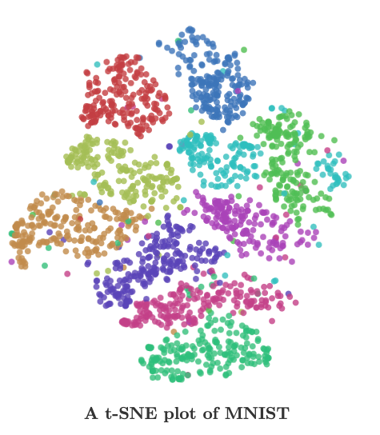
Assignment
Visualization using PCA
Expected output
Run the same analysis using 42K points with various of perplexity and iterations.(as shown in the jupyter notebook)
If you use all of the points, you can expect plots like this blog below: http://colah.github.io/posts/2014-10-Visualizing-MNIST/

